Slide 1
Simplified Constitution of the United States of America
Created by Aaron T. Laron
Last updated on Friday, November 13, 2020

Slide 2
Opening Statement
We the People of the United States, in Order to form a more perfect Union, establish Justice, insure domestic Tranquility, provide for the common defence, promote the general Welfare, and secure the Blessings of Liberty to ourselves and our Posterity, do ordain and establish this Constitution for the United States of America.

Slide 3
Article 1
Creates the two parts of Congress – Called the Legislative Branch

Slide 4
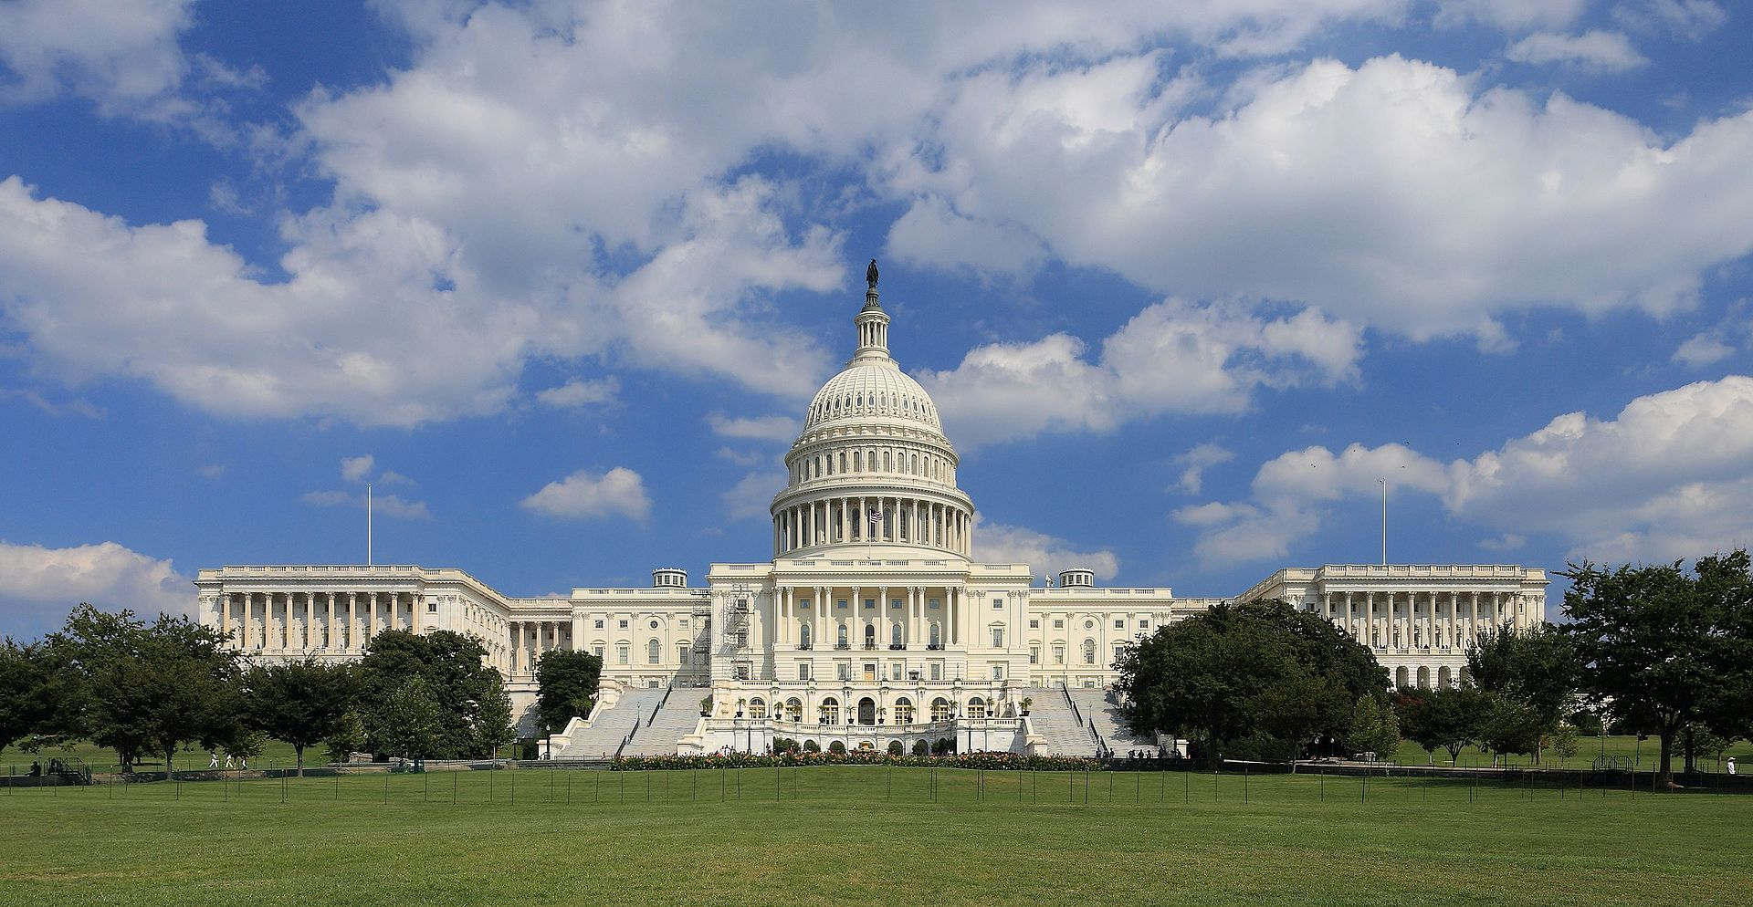
Article 1 – Section 1
Creates the two parts of Congress – Called the Legislative Branch

Slide 5
Article 1 – Section 2
Defines the House of Representatives, known as the lower house of Congress.
Must be 25 years old, will serve for two years each. Must be a citizen 7 years.
Each state gets Representatives based on state population.
Has a leader called the Speaker of the House.

Slide 6
Article 1 – Section 3
Defines the Senate, known as the upper house of the Congress.
Must be 30 years old, will serve for six years each.
Must be a citizen 9 years.
Each state gets two Senators.
Vice-President breaks tie votes.

Slide 7
Article 1 – Section 4
Says that each state may establish its own methods for electing members of the Congress.
Requires, that Congress must meet at least once per year.

Slide 8
Article 1 – Section 5
Says that Congress must have a minimum number of members present in order to meet.
Fines for members who do not show up. It says that members may be expelled.
Each house must keep a journal to record proceedings and votes.
Neither house can adjourn without the permission of the other.

Slide 9
Article 1 – Section 6
Establishes that members of Congress will be paid.
They cannot be detained while traveling to and from Congress.
That they cannot hold any other office in the government while in the Congress.

Slide 10
Article 1 – Section 7
Say how bills become law.
All bills must pass both houses of Congress in the exact same form.
Bills that pass both houses are sent to the President.
He can either sign the bill, in which case it becomes law, or he can veto it.
If he vetoes a bill, it is sent back to Congress, and if both houses pass it by a two-thirds majority, the bill becomes law over the President's veto. This is known as overriding a veto.

Slide 11
Article 1 – Section 8
Gives Congress the power to establish and maintain an army and navy.
To establish post offices, to create courts, to regulate commerce between the states, to declare war, and to raise money.

Slide 12
Article 1 – Section 9
Cannot suspend right to remain silent laws.
Cannot pass laws that make things illegal starting yesterday or last week, etc.
No law can give preference to one state over another
Cannot spend money without permission.

Slide 13
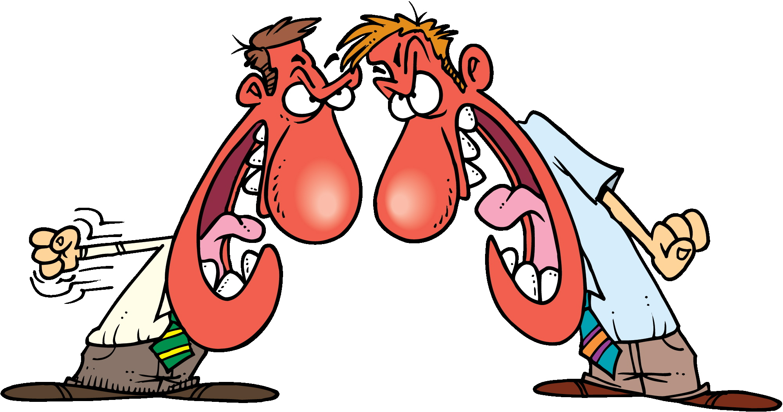
Article 1 – Section 10
States cannot
Print their own money
Declare war on another state
Tax goods from another state

Slide 14
Article 2
Creates the job of President, called the Executive

Slide 15
Article 2 – Section 1
Establishes the office of the President and the Vice-President.
Both serve for four years.
Presidents are elected by the Electoral College.
Must be 35 years old. Must be born in the USA.
Their pay cannot change, up or down, as long as he in is office.

Slide 16
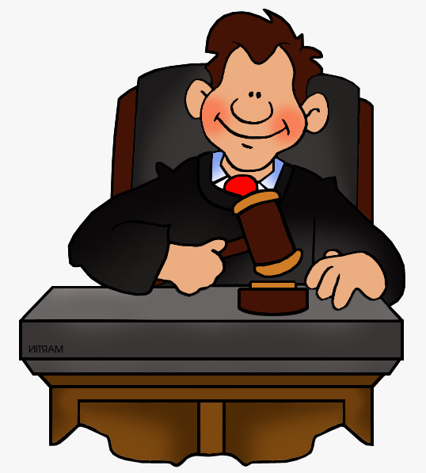
Article 2 – Section 2
President leads the armed forces.
He has a Cabinet to aid him and can pardon criminals.
He makes treaties with other nations.
Picks many of the judges and other members of the government

Slide 17
Article 2 – Section 3
President must give a yearly speech to the nation.
Give suggestions to Congress.
Meet with Ambassadors and other heads of state from other nations.
Ensure the laws of the United States are carried out.

Slide 18
Section 2 – Article 4
Explains how to kick the president from office, called impeachment.

Slide 19
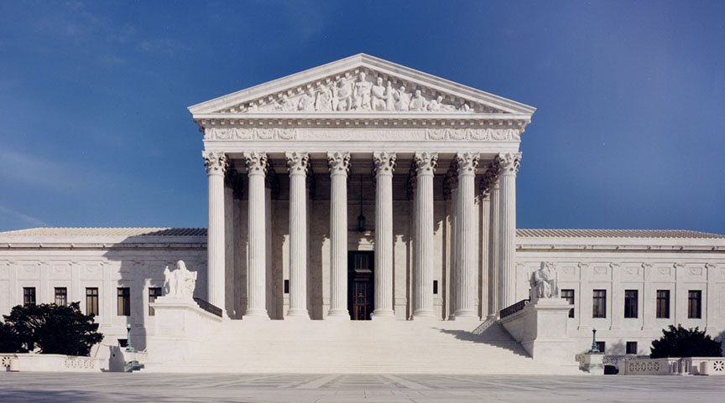
Section 3
Establishes Judges, called the Judiciary

Slide 20
Article 3 – Section 1
Establishes the Supreme Court, the highest court in the United States.
Judges serve for life, or until they want to retire.

Slide 21
Section 3 – Article 2
Says what cases the Supreme Court must decide.
It also guarantees trial by jury in criminal court.

Slide 22
Section 3 – Article 3
Defines, without any question, what the crime of treason is.

Slide 23
Article 4
States Rights

Slide 24
Article 4 – Section 1
All states will honor the laws of all other states.

Slide 25
Article 4 – Section 2
Citizens of one state are treated equally and fairly like all citizens of another.
It also says that if a person accused of a crime in one state flees to another will be returned to the state that person fled from.

Slide 26
Article 4 – Section 3
Explains how new states may come into the Nation.
Control of federal lands.

Slide 27
Article 4 – Section 4
Ensures a “Power by the People” government.
Guarantees that the federal government will protect the states.

Slide 28
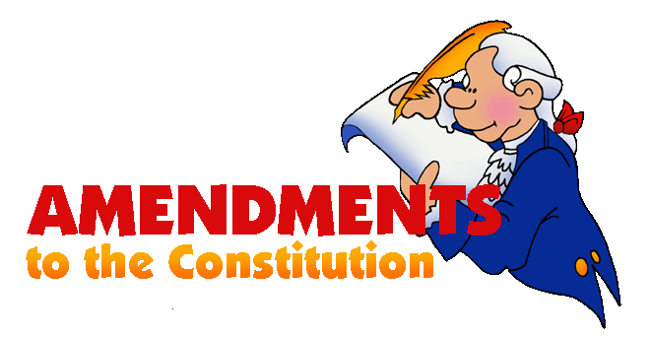
Article 5
Explains how to change the Constitution if we don’t like part of it any more.

Slide 29
Article 5
Representatives must vote on the change.
Senators must vote on the change.
2/3 of the States must vote for the change.

Slide 30
Article 6
Concerns of the United States

Slide 31
Article 6
Guarantees that the Constitution and all laws and treaties of the United States to be the supreme law of the country.
Requires all officers of the United States and of the states to swear an oath of allegiance to the United States and the Constitution when taking office.

Slide 32
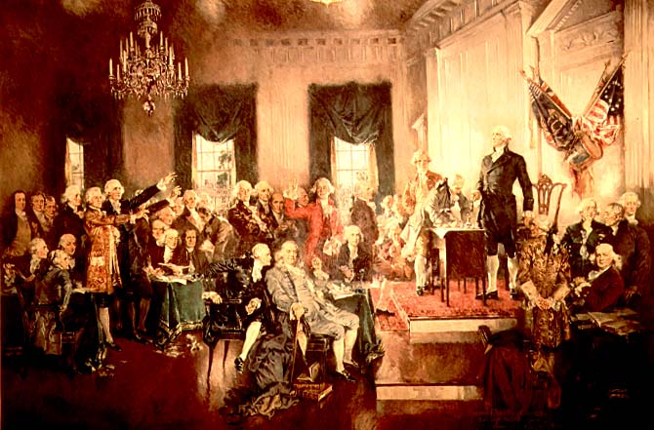
Article 7
How the Constitution was agreed on

Slide 33
Article 7
Of the original 13 states in the United States, nine had to accept the Constitution before it would officially go into effect.

Slide 34
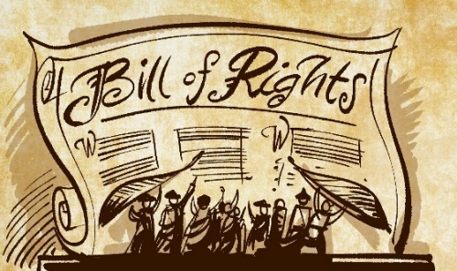
The Bill of Rights

Slide 35
The Bill of Rights
After the Constitution was written and signed, they realized that they forgot to list what rights the PEOPLE of the nation had.
They decided on 10 rights.

Slide 36
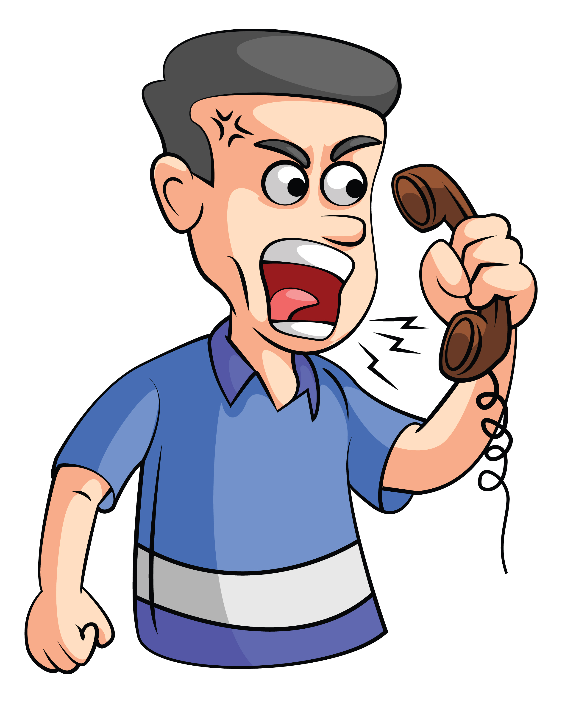
1st Amendment
Protects the people's right to
Practice any religion
To speak freely
To assemble (meet)
To address the government
The press to publish newspapers or other written material.

Slide 37
2nd Amendment
Protects the right to own guns.

Slide 38
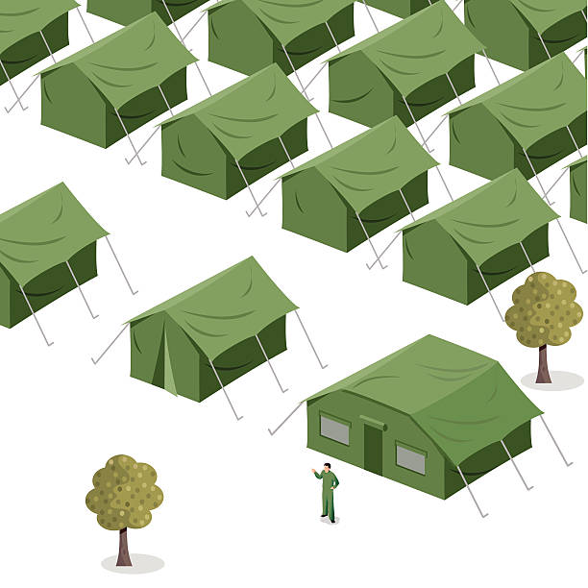
3rd Amendment
Guarantees that the army cannot force homeowners to give them room and board.

Slide 39
4th Amendment
Protects the people from the government improperly taking property, papers, or people, without a valid warrant based on probably cause (good reason).

Slide 40
5th Amendment
Protects people from being held for committing a crime unless they are properly indicted
That they may not be tried twice for the same crime
That you need not be forced to testify against yourself.
It also contains due process guarantees.

Slide 41
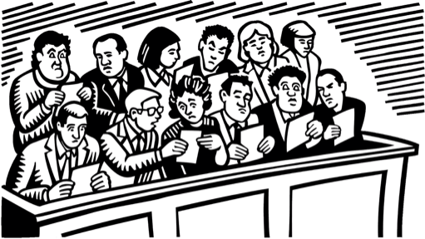
6th Amendment
Guarantees a speedy trial, an impartial jury, and that the accused can confront witnesses against them, and that the accused must be allowed to have a lawyer.

Slide 42
7th Amendment
Guarantees a jury trial in federal civil court cases. This type of case is normally no longer heard in federal court.

Slide 43
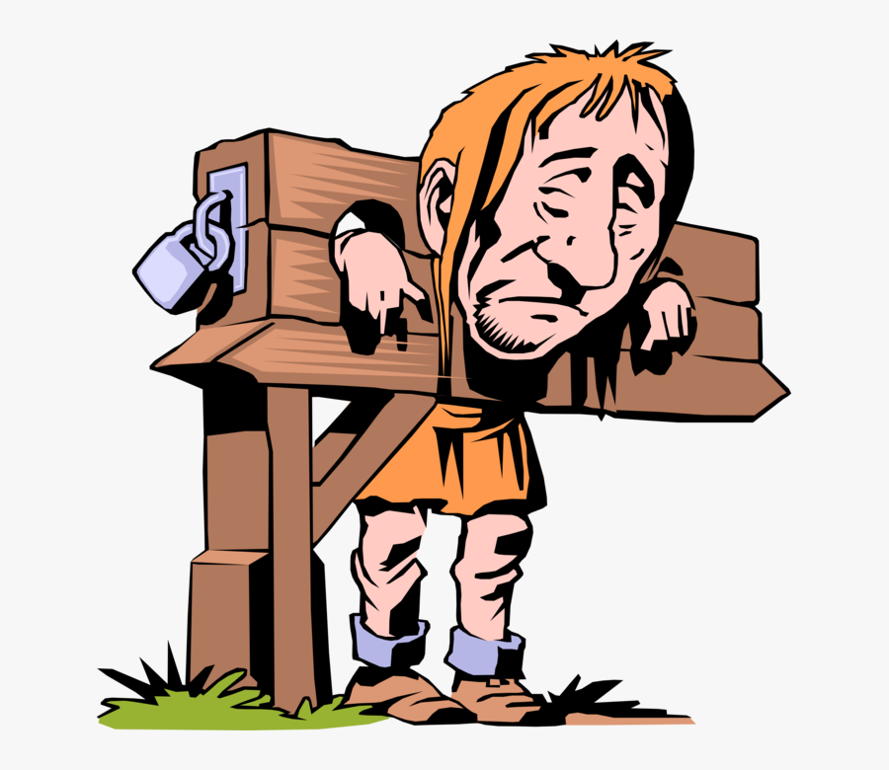
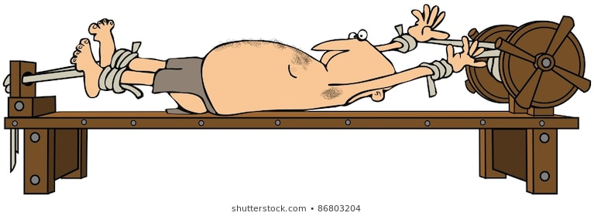
8th Amendment
Guarantees that punishments will be fair, and not cruel, and that extraordinarily large fines will not be set.

Slide 44
9th Amendment
Simply a statement that other rights aside from those listed may exist, and just because they are not listed does not mean they can be violated.

Slide 45
10th Amendment
Says that any power not granted to the federal government belongs to the states.

Slide 46
Amendments Passed Later

Slide 47
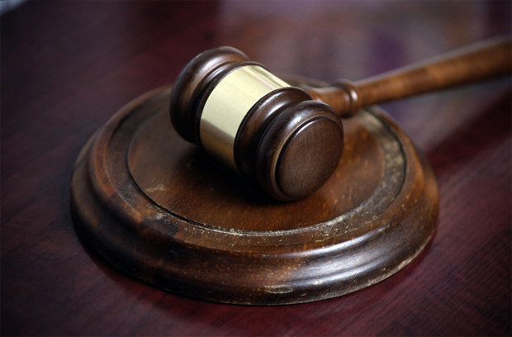
11th Amendment - 1798
Says how someone from one state can sue another state.

Slide 48
12th Amendment - 1804
Redefines how the President and Vice-President are chosen by the Electoral College.

Slide 49
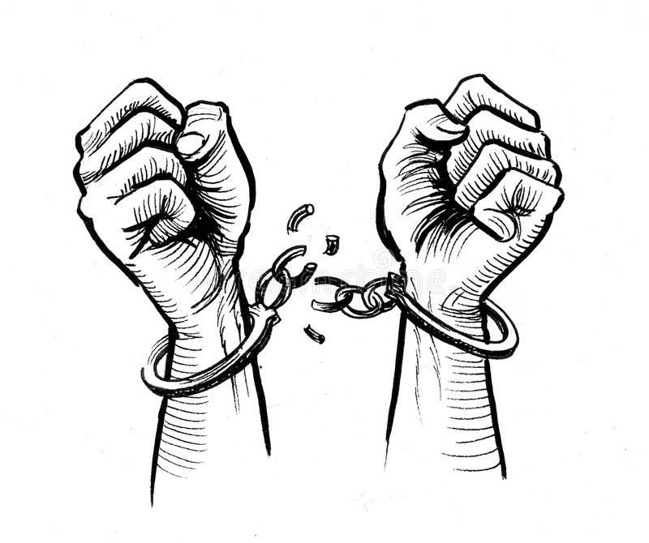
13th Amendment - 1865
Abolished slavery in the entire United States.

Slide 50
14th Amendment - 1868
People had rights on the federal level and on the state level, too.
Dealt with civil war items.

Slide 51
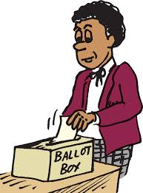
15th Amendment - 1870
Ensured that a person’s race could not be used as criteria for voting.

Slide 52
16th Amendment
Authorizes the United States to collect income taxes.

Slide 53
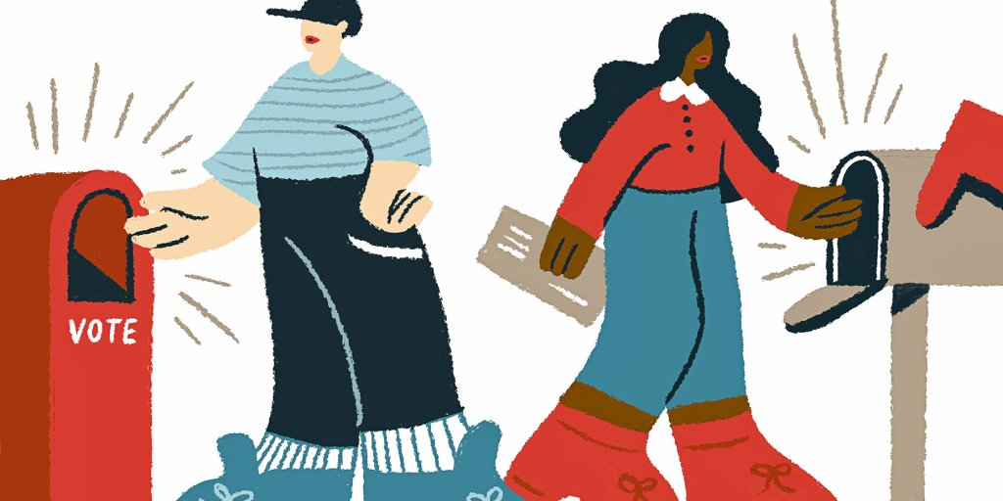
17th Amendment - 1913
Shifted the choosing of Senators from the state legislatures to the people of the states.

Slide 54
18th Amendment - 1919
Abolished the sale or manufacture of alcohol in the United States.

Slide 55
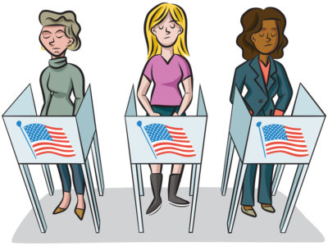
19th Amendment - 1920
Ensures that a persons sex could not be used as a criteria for voting.

Slide 56
20th Amendment - 1933
Set new start dates for the terms of the Congress and the President.

Slide 57
21st Amendment - 1933
Repealed the 18th Amendment (banning alcohol).

Slide 58
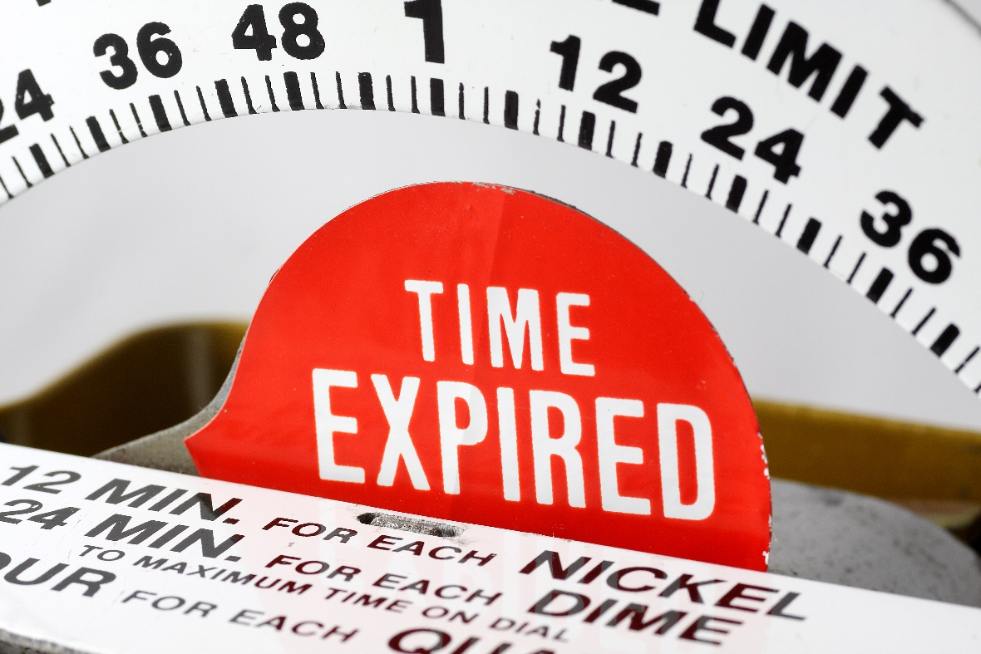
22nd Amendment - 1951
Set a limit on the number of times a President could be elected - two four-year terms.

Slide 59
23rd Amendment - 1961
Grants Washington D.C. the right to three electors in Presidential elections.

Slide 60
24th Amendment - 1964
Ensured that no tax could be charged to vote for any federal office.

Slide 61
25th Amendment - 1967
Establishes rules for a President who becomes unable to perform his duties while in office.

Slide 62
26th Amendment - 1971
Ensures that any person 18 and over may vote.

Slide 63
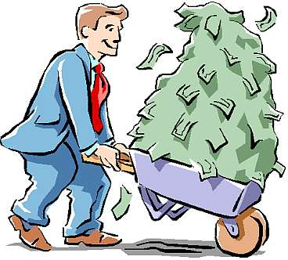
27th Amendment - 1992
Any law that increased the pay of legislators may not take effect until after an election.

Slide 64
Thanks for learning with me

